Slide 1

Indeed.com Job Posts Analysis
Presented By:
Vamshi Darshanam
Batch No.: 442
Innomatics Research Labs
Dilsukhnagar

Slide 2
Agenda (This should be the PPT flow)
Business Problem
Problem Statement
Business Objective
Data Preprocessing
Analysis and Interpretation
Hypothesis Testing
Business Insights & Recommendations
Challenges
Conclusion

Slide 3
Business Problem
The job market is rapidly evolving, driven by technological advancements, shifting industry demands, and changing workforce expectations. Job seekers face challenges in understanding which roles, skills, and locations offer the best career opportunities. Without reliable insights, both employers and professionals risk making uninformed decisions that lead to talent gaps, inefficient hiring, and missed career growth opportunities.

Slide 4

Problem Statement
There is a lack of structured, data-driven insights into current job market trends. Job seekers lack clarity on the most promising career paths, salary expectations, and skill requirements. By analyzing job postings data from platforms like Indeed.com, actionable insights can be generated to bridge this gap, enabling job seekers to make informed career decisions.

Slide 5
Business Objectives
Analyze job demand to identify the most in-demand roles, industries, and companies hiring across multiple positions.
Examine salary trends by job role, experience level, and location to understand compensation patterns.
Identify the most sought-after skills for each role and assess demand for emerging technologies such as AI, Cloud, and BI.
Perform location-based analysis to determine regions with the highest job availability and salary variations.
Provide actionable recommendations to job seekers on skill development.

Slide 6
Data Preprocessing
Handled missing values by identifying jobs with unavailable salary, rating, experience, or skills and assigning None/NaN to maintain data consistency.
Standardized salary data by converting monthly salaries into yearly value.
Extracted experience requirements from unstructured job descriptions using regular expressions to derive minimum and maximum experience in years.
Performed skill extraction and normalization by mapping unstructured job descriptions to a predefined skill set (e.g., Python, SQL, Power BI, ML)..
Converted categorical variables (job role, location, company) into structured columns suitable for grouping and aggregation during analysis.
Filtered irrelevant or noisy records, such as jobs without valid titles or descriptions, to improve data quality.

Slide 7
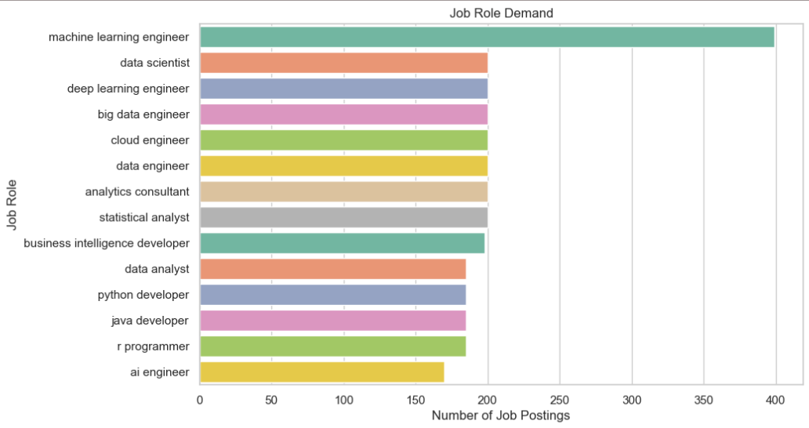
Analysis and Interpretation
Univariate Analysis
Job Demand
Insight:
This shows which roles are currently most in-demand.
Data Engineer and Data Analyst are Most in-demand job roles

Slide 8
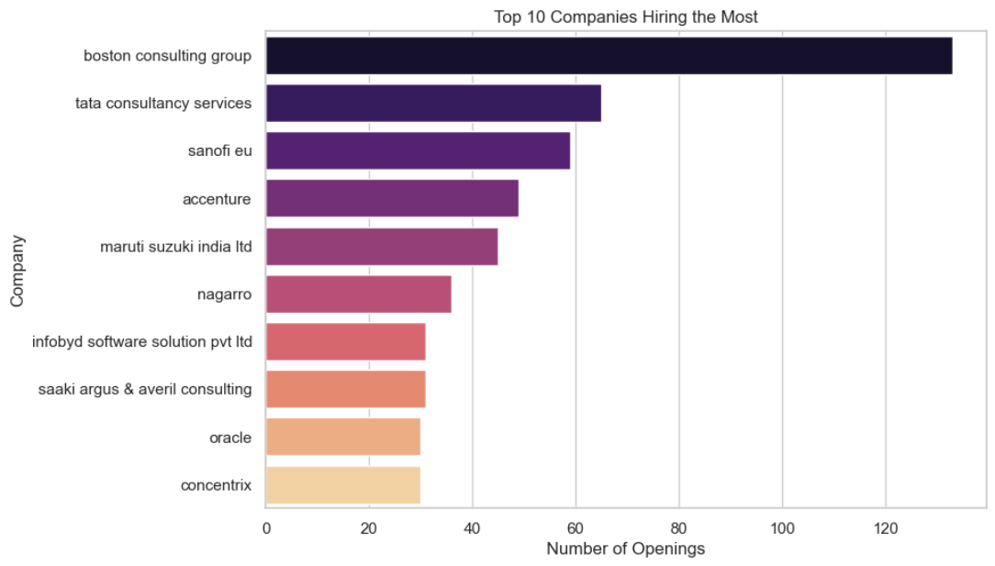
Companies Hiring the Most
Insight:
Shows which companies are actively hiring multiple roles

Slide 9
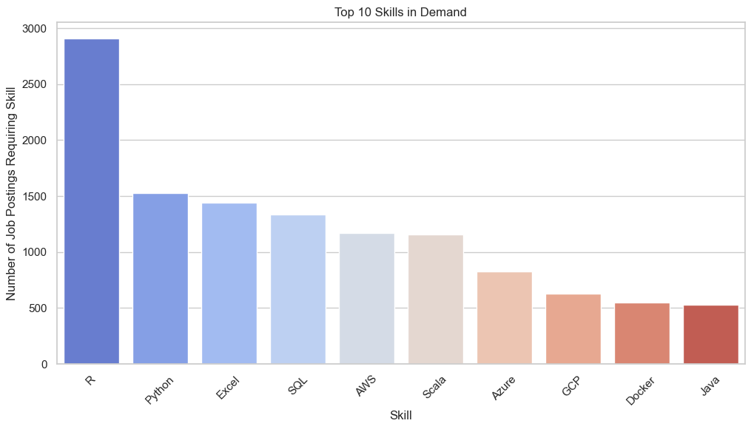
Skills in Demand
Insight:
Shows the most requested skills, e.g., 'R’, 'Python', 'SQL', 'Power BI', 'Machine Learning'.

Slide 10
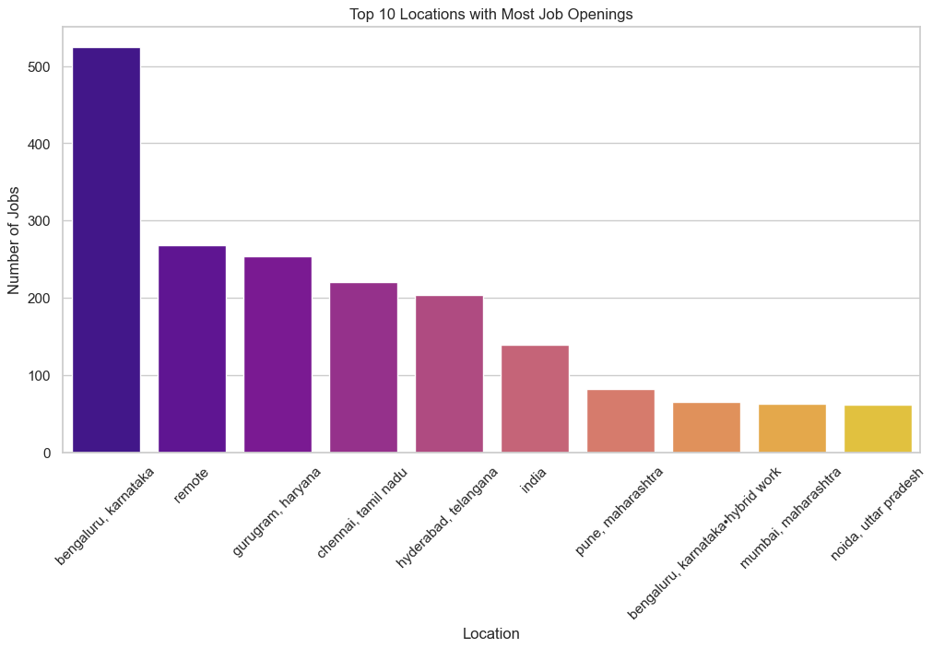
Job availability by Location
Insight:
Highlights cities with the highest demand, Bangalore, Haryana, Chennai.

Slide 11
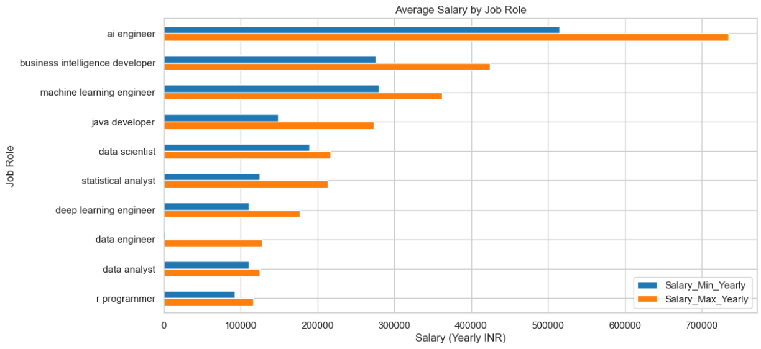
Bi-Variate Analysis
Salary Analysis by Job Role
Insight:
Identify which roles pay the highest on average.
Typically, Business Intelligence developer and Machine Learning Engineer'

Slide 12
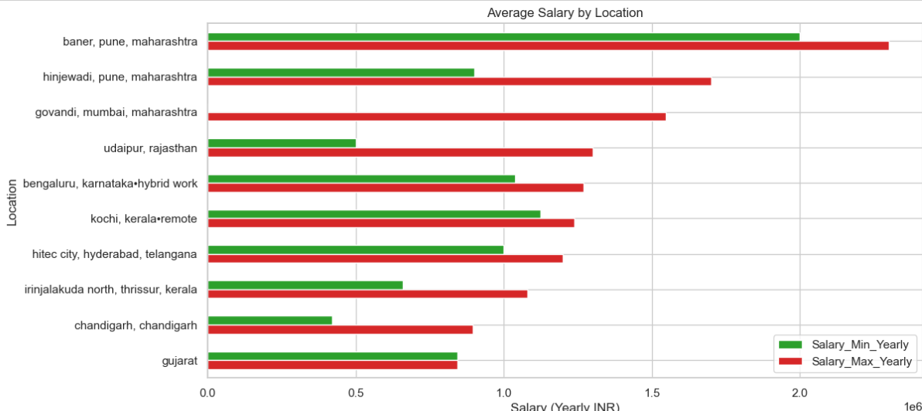
Salary Comparison Across Locations
Insight:
Shows where salaries are highest; often metro cities pay more.

Slide 13
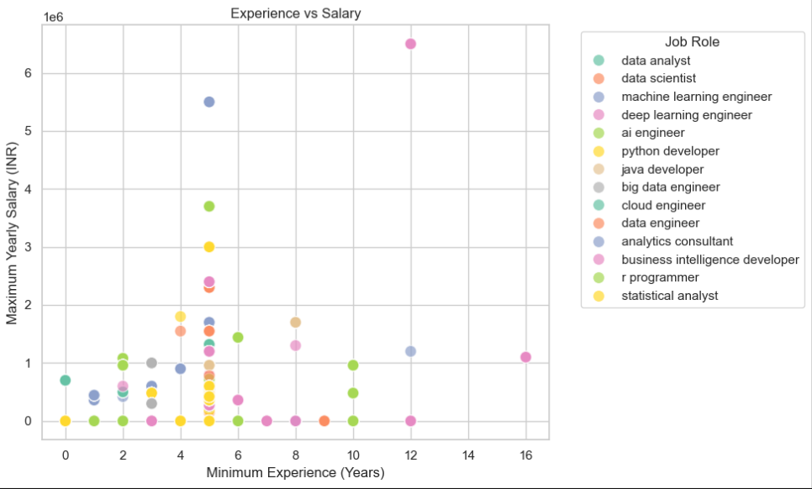
Experience vs Salary
Roles like Machine Learning Engineer, Deep Learning Engineer, and AI Engineer show very high salaries even with 0–3 years of experience.
Insights:
Roles like ML, DL & AI Engineer show very high salaries even with 0-3 year of experience
Python and Java Developer shows wide salary variation across all experience levels.

Slide 14
Hypothesis Testing
Is there a significant salary difference between Data Scientists and Data Analysts?
Hypotheses
H₀ (Null): Mean salary of Data Scientists = Mean salary of Data Analysts µ(DS)=µ(DA)
H₁ (Alternative): Mean salary of Data Scientists ≠ Mean salary of Data Analysts µ(DS)≠µ(DA)
Test Type: Independent T-Test
T-statistic: 1.811926313807265
P-value: 0.07089268833115335
Fail to Reject H0: No significant salary difference
Insights:
Salary difference is not statistically significant
Other factors likely influence salary more than role
Salary ranges overlap for Data Scientists and Data Analysts

Slide 15
Do jobs requiring higher experience pay more?
Hypotheses
H₀: Mean salary for low-experience jobs = high-experience jobs
H₁: Mean salary for high-experience jobs > low-experience jobs
Test Type: One-tailed T-Test
T-statistic: 1.7857889834923193
P-value: 0.07451034095842601
Fail to Reject H0
Insights:
No significant salary difference between low- and high-experience jobs at the 5% level.
Higher-experience jobs show a slight upward trend, but evidence is weak.
Salary is influenced more by role, skills, company, and location than experience alone.

Slide 16
Insights & Recommendations
Data Scientist and Data Analyst positions dominate the job market; targeting these roles increases employability.
Core skills like Python, SQL, Power BI, Machine Learning, and Cloud are essential; emerging skills like AI and Deep Learning are increasingly in demand..
AI, ML, and Cloud-related positions generally offer higher salaries and more specialized career paths.
Firms like TCS, Infosys, and Amazon post multiple roles; applying to such companies increases chances of selection.
Cities like Bangalore, Hyderabad, Pune, and Mumbai have the highest job availability; metro locations often offer better salaries.
Jobs requiring more skills or specialized expertise tend to offer higher growth and compensation opportunities.
Job seekers should focus on building in-demand skills and targeting high-demand roles/locations; companies should benchmark salaries, hire skill-focused talent, and invest in employer branding to attract top candidates.

Slide 17
Challenges
During this project, several challenges were encountered from data collection to preprocessing. Scraping job postings from Indeed was difficult due to dynamic content, JavaScript rendering, pagination, and anti-bot mechanisms, which required using tools like Selenium and undetected ChromeDriver. Extracting structured information was complicated because salary, experience, and skills were reported in varied formats, necessitating careful parsing and standardization. Many fields contained missing values or duplicates, while categorical data such as job roles, job types, and locations needed consistent naming. Preparing the data for analysis also involved normalizing skills, converting salaries to yearly figures, and aligning experience ranges, ensuring the dataset was clean for statistical analysis and visualization. Finally, creating readable visualizations was challenging due to overlapping labels and outliers, requiring horizontal plots, resizing, and numeric-focused multivariate charts.

Slide 18
Conclusion
The project analyzed Indian job postings to uncover trends in demand, salaries, skills, and locations. AI, Machine Learning, Data Science, and Cloud roles dominate demand and offer the highest salaries. Experience and skill count strongly influence compensation, while entry-level salaries remain lower. Metro cities like Bangalore, Hyderabad, Pune, and Mumbai provide the most opportunities and better pay. The findings help job seekers focus on in-demand roles and skills.

Slide 19

THANK YOU

